Slide 1
Exact Calculation for Depth of Cut (h)
s
Θ
Basic Equations
S=D+x
x=D-2htanΘ
h
x
D
D: Bit diameter (fixed)
Θ: Bit angle (fixed)
S: Spacing (adjustable)
Depth of Cut h=(2D-S)/2tanΘ

Slide 2
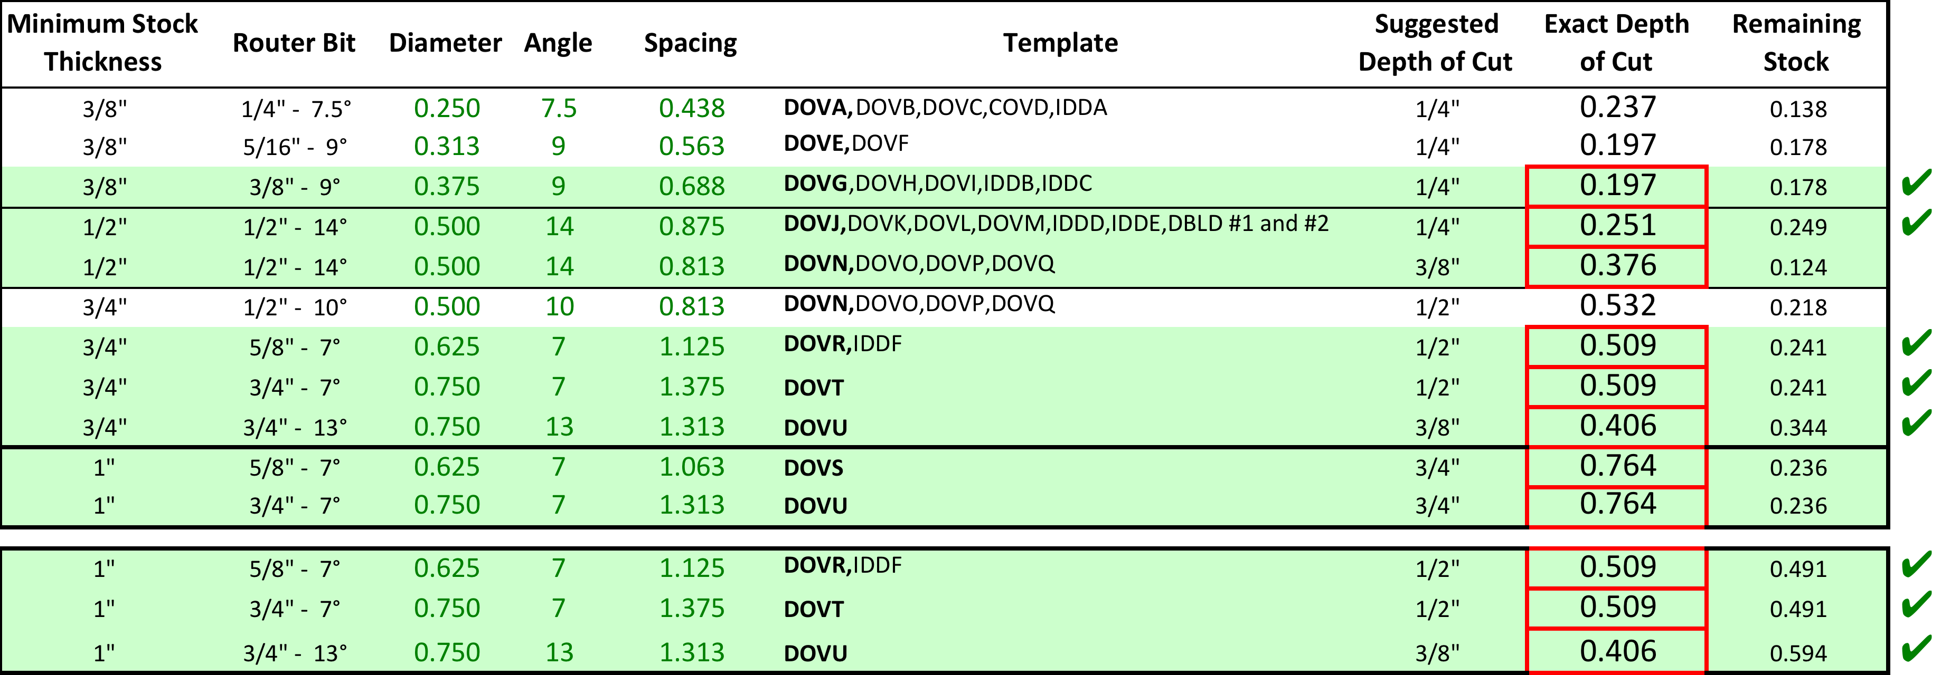
Exact Calculation for Depth of Cut (h)

